Slide 1

Determination and verification of cellular mobile reception indoor terrain model for zenith building cinec campus
EE4700 INDIVIDUAL RESEARCH PROJECT FINAL PRESENTATION
Supervisor – Mr. Srimal punchihewa
Student name – K.K.Jayani naeera
Student id – F19990514008

Slide 2
Introduction, Objective, Gap, Novelty
Introduction:The Zenith building's steel and concrete construction weakenss cellular signal. This Project proposes In-Building Solutions to improve signal strength and give solution for that .
Objective: Identify cellular signal strength on each floor to find weak spots and plan improvements.
Novelty: In-Building Solutions with a detailed indoor signal map to address weak signal in steel buildings (for zenith building)
Gap: More efficient use of IBS,Improved signal quality, address weak signal zones.

Slide 3
Deliverables
Milestones
Comparing and analysing all seven floors, walk testing details
Provide a fully implemented In-Building Solutions (IBS) system within the Zenith building. This includes the installation of distributed antenna systems (DAS), small cells, repeaters, and other necessary components to enhance cellular signal strength
Proposed Milestones | Achieved
Milestone 1: Data collection on cellular signal strength throughout the 7 floors of the building. | Achieved
Task 1.1: Search about research papers for data collection & walk testing inside the building. | Achieved
Task 1.2: Collecting data using different phones. | Achieved
Milestone 2: Model Development | Achieved
Task 2.1: Design and studying Cad drawing of the building | Achieved
Task 2.2: Searching about IBS and antenna systems of the buildings | Achieved
Milestone 3: Data collection on cellular signal strength throughout the seven floors of the building. | Achieved
Task 3.1: Analyzing collected data using Matlab. | Achieved
Task 3.2: Searching Soft-wares and simulate the propagation of cellular signals inside the building using matlab | Achieved
Milestone 4: Finalizing Data | Achieved
Task 4.1: Data comparing and analayzing with real world measurements and give repeater system solution. | Achieved
Task 4.2: Creating final report and presentation. | Achieved

Slide 4
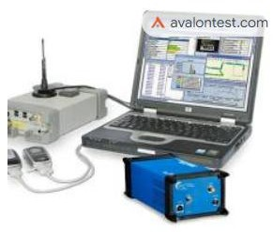
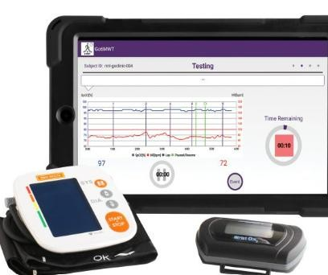
PROJECT METHODOLOGY
Data collection
Drive testing
G-NetTrack Lite" is a mobile network testing and analysis tool that allows users to perform drive testing and walk testing to evaluate and analyze the performance of mobile networks. Drive testing involves assessing network quality while moving, typically in a vehicle, while walk testing involves doing the same on foot.
Walk testing

Slide 5
PROJECT METHODOLOGY
Indoor mapping (softwares)/Cellular signal strength measurement device
- : Indoor mapping software is used to create a
map of the building's interior. This map can then be used to collect data on cellular signal strength at different locations in the building.
Examples of indoor mapping software:
Ekahau Sidekick,AirMagnet Survey Pro,InSite Wireless
Model development
Computer-aided design (CAD) software- used to create a 3D model of the building's interior. This model will be used to input the building's layout and materials into the electromagnetic simulation software
Ex -AutoCAD, Revit ,SolidWorks
Electromagnetic simulation software- used to simulate the propagation of cellular signals in the building and to generate the indoor terrain model. This software will take into account the building's layout, materials, and other factors that can affect signal propagation.
Ex-FEKO,CST MICROWAVE STUDIO

Slide 6
PROJECT METHODOLOGY
Data analysis software -Data analysis software is used to analyze the collected data and to validate the indoor terrain model. This software will be used to identify patterns and trends in the data and to compare the model's predictions to actual measurements of cellular signal strength.
Examples of data analysis software: MATLAB
Model verification
Comparison of model predictions to actual measurements of cellular signal strength throughout the building

Slide 7
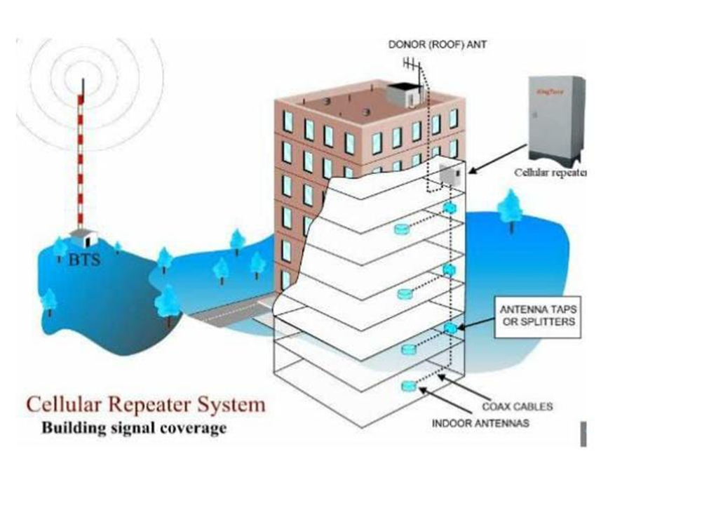
Solution _(Install DAS Repeater System)

Slide 9
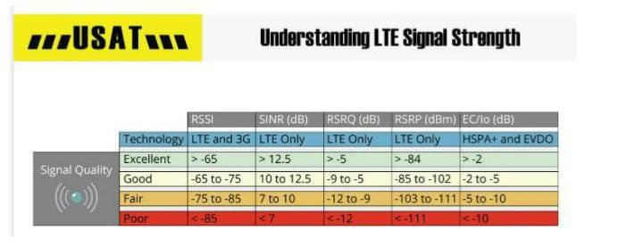
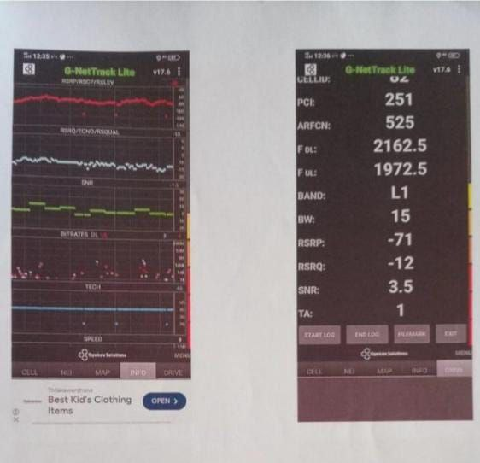
Results and discussion
Signal strength diagram
Vivo out side of the building walk testing result 1

Slide 10
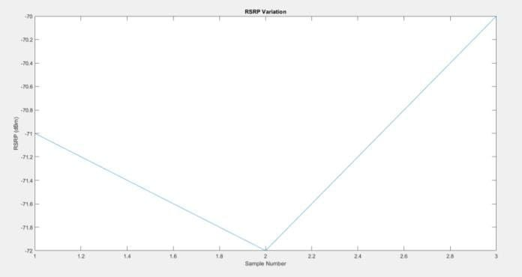
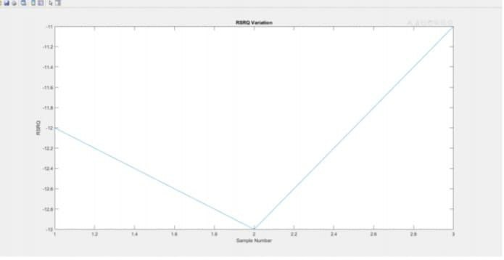
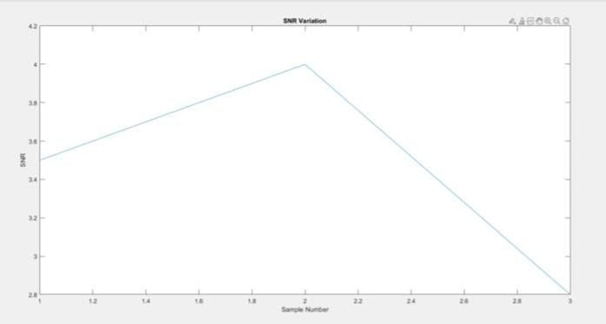
RSRP verification results using matlab(VIVO)
Rsrq verification result of Matlab(VIVO)
SNR verification result of out side of the building
Good-RSRQ (-12)
Acceptable- RSRP (-71 dBm)
Needs improvement - SNR (3.5)
RSRP: -71 dBm: This is a strong
Finalize result of out side of the building

Slide 11
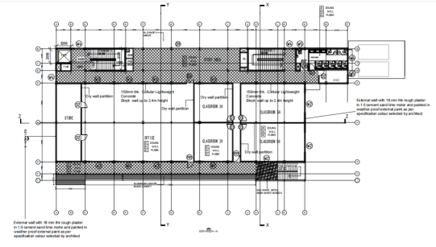
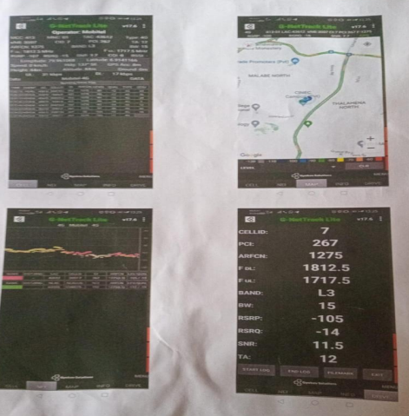
1st-floor result, verification, and implementation
1st-floor cad drawing
Walk testing result of first floor

Slide 12
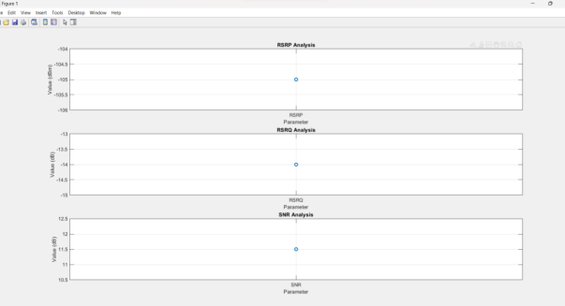
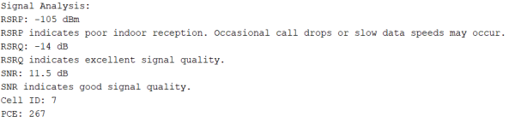
1st floor finalizing verification result of Matlab , signal power is lower than outside of the building .

Slide 13
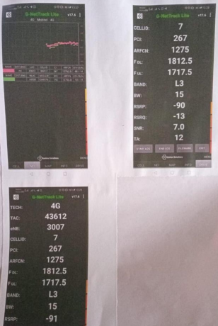
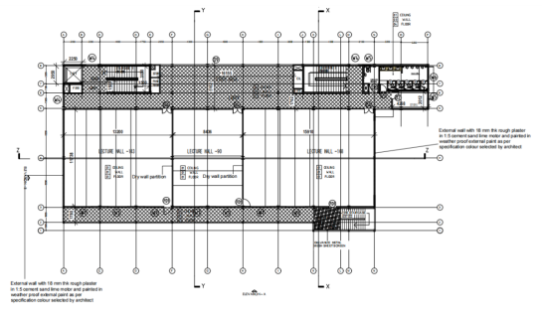
2nd-floor result, verification, and implementation
Cad drawing of 2nd floor
Walk testing result of 2nd floor

Slide 14
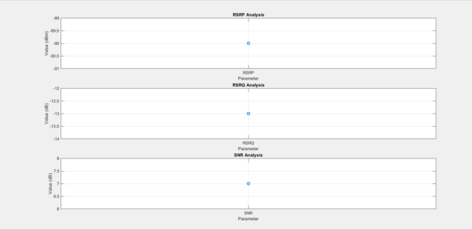
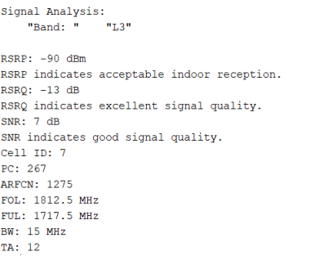
(MATLAB verification result) signal strength on the 2nd floor appears acceptable for basic use, judging by the RSRP,
RSRQ, and SNR values. However, occasional call drops or slow data speeds may still occur

Slide 15
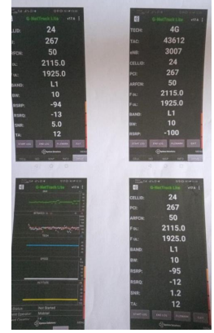
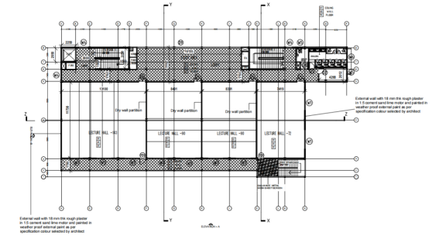
3rd floor result, verification, and implementation
Cad drawing of 3rd floor
Walk testing result of 3rd floor

Slide 16
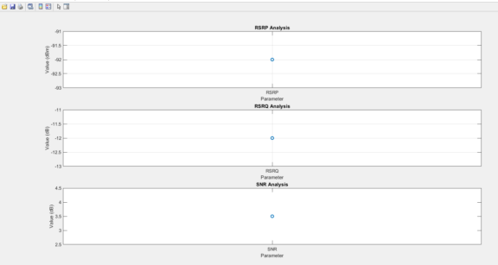
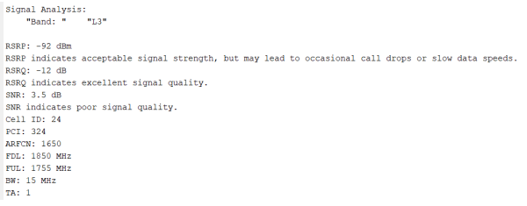
(MATLAB result)Signal strength seems acceptable for basic use on the 2nd floor based on the RSRP and RSRQ
values. However, the SNR is low, suggesting you might experience more frequent call drops or
slow data speeds compared to a higher SNR value.

Slide 17
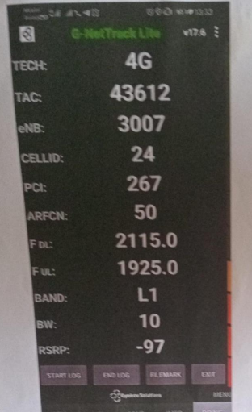
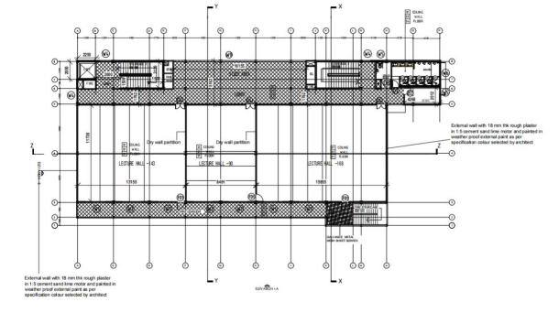
4th floor result, verification, and implementation
4th floor cad drawing
Walk testing result of 4th floor

Slide 18
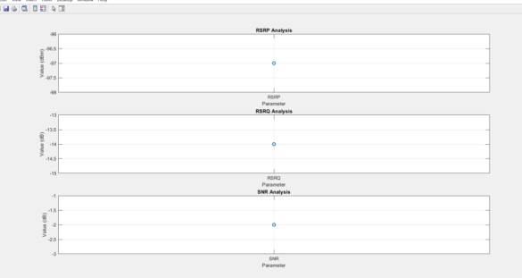
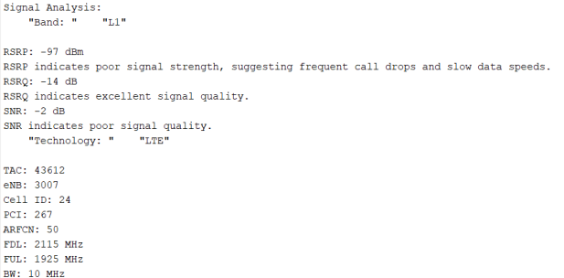
(Matlab)Overall, the signal strength appears weak based on the RSRP and SNR values. You're likely to experience frequent call drops and slow data speeds on the 4th floor

Slide 19
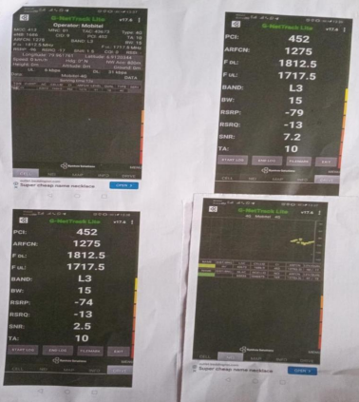
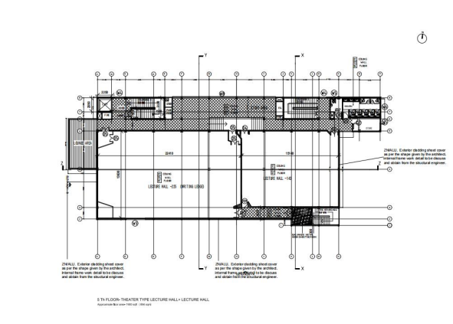
5th floor result, verification, and implementation
Cad drawing of the 5th floor
Walk testing

Slide 20
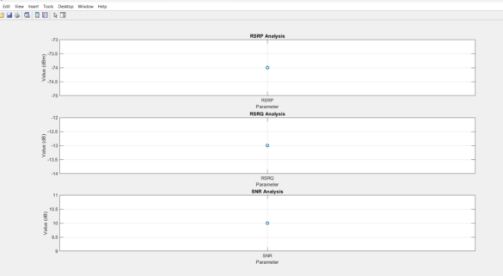
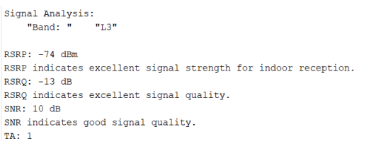
Overall, the signal strength on the 5th floor appears good based on the RSRP, RSRQ, and SNR
values. Experience good call quality and data speeds.

Slide 21
Conclusion
Improved User Experience: By identifying and addressing weak reception areas, the project will significantly enhance cellular connectivity for occupants within the Zenith building.
Enhanced Campus Infrastructure: Implementing the model ensures reliable cellular service throughout the building, benefiting both occupants and stakeholders on campus.
Advancement in In-Building Communication: This project serves as a testament to the team's dedication to improving indoor cellular communication systems

